Slide 1
Disturbances of pigmentation
By dr .yasmeen jasim

Slide 7
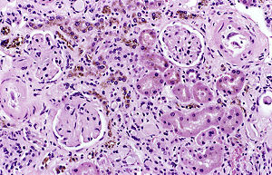
Hemosiderosis
Hemosiderosis is a form of iron overload disorder resulting in the accumulation of hemosiderin.
Hemosiderosis has two main causes:
bleeding within an organ or area of tissue
red blood cells breaking down within your bloodstream

Slide 12
Porphyria
Porphyria : refers to a group of disorders that result from a buildup of natural chemicals that produce porphyrin in your body. Porphyrins are essential for the function of hemoglobin — a protein in your red blood cells that links to porphyrin, binds iron, and carries oxygen to your organs and tissues. High levels of porphyrins can cause significant problems

Slide 16
B- Non hematogenous endogenous pigment
Melanin
melanosis : is a form of hyperpigmentation associated with increased melanin. It can also refer to: Melanism. Ocular melanosis. Smoker's melanosis

Slide 17
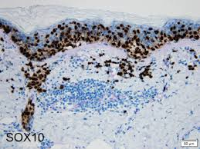
Melanosis of skin

Slide 18
Lipofusine
lipid-containing residues of lysosomal digestion. It is considered to be one of the aging or "wear-and-tear" pigments, found in the liver, kidney, heart muscle, retina, adrenals, nerve cells, and ganglion cells

Slide 19
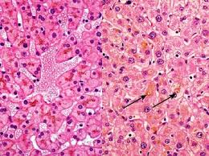
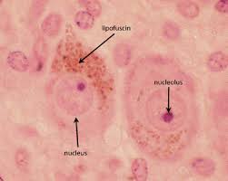
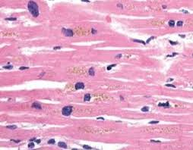
Lipofusine pigment
Liver neuron muscles

Slide 20
Exogenous pigments

Slide 21
Anthracosis
Anthracosis (anthrac- meaning coal, carbon + -osis accumulation of carbon in the lungs due to repeated exposure to air pollution or inhalation of smoke or coal dust particles” meaning condition).
”

Slide 22
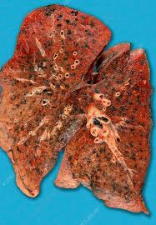
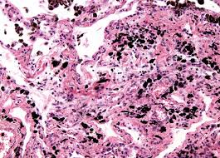
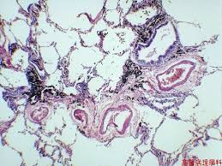
Anthracosis
Lung : accumulation of carbon in the lungs

Slide 24
Albinism
Absence of pigment in the skin, hair and eyes. Albinism is associated with a number of vision defects, such as photophobia, nystagmus, and amblyopia. Lack of skin pigmentation makes for more susceptibility to sunburn and skin cancers.

Slide 26
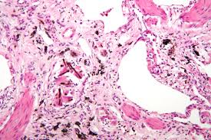
Asbestosis
Asbestosis is caused by breathing in asbestos fibers. It requires a relatively large exposure over a long period of time, which typically only occur in those who directly work with asbestos.

Slide 27
jaundice
jaundice : refers to a build up of yellow pigment in the blood and tissue, which causes a yellow discoloration in the skin, gums, and eyes. This is also called icterus or yellow jaundice. It's fairly easy to spot in dogs,
The build up of bilirubin in the blood that causes this is toxic and affects the liver, kidney, and brain tissue.

Slide 28
Symptoms
Discolored urine
Increased thirst or urination
Vomiting
Diarrhea
Loss of appetite
Lethargy
Weakness
Paleness
Fever
Abdominal pain
Orange tint to feces
Weight loss
Bleeding

Slide 29
jaundice
There are a few conditions that might cause jaundice in dogs:
Autoimmune disease
Cancerous tumours
Heartworm
Cirrhosis or liver damage, often from toxins
Pancreatic inflammation, stones, cancer, or infection
Bile duct obstruction
Injury
Collection of blood in the body cavity

Slide 30
Types of jaundice

Slide 31
Normally, bilirubin is delivered from the bloodstream into your liver. Then, it passes through tubes called bile ducts. These ducts carry a substance called bile into your small intestine. Eventually, bilirubin is passed out of your body through urine or stool.
Types of jaundice are categorized by where they happen within the liver’s process of taking in and filtering out bilirubin:
pre-hepatic: before the liver
hepatic: in the liver
post-hepatic: after the liver

Slide 32
Pre-hepatic jaundice is caused by conditions that heighten your blood’s rate of hemolysis. This is the process through which red blood cells are broken down, releasing hemoglobin and converting into bilirubin.
Because the liver can only process so much bilirubin at once, bilirubin overflows into bodily tissues.
The most common causesTrusted Source of pre-hepatic jaundice are:
malaria, a blood infection caused by a parasite
sickle cell anemia, a genetic condition in which red blood cells become crescent-shaped rather than the typical disc shape

Slide 33
Hepatic jaundice happens when your liver tissue is scarred (known as cirrhosis), damaged, or dysfunctional. This makes it less effective at filtering out bilirubin from your blood.
Since it can’t be filtered into your digestive system for removal, bilirubin builds up to high levels in your blood.

Slide 34
The most common causesTrusted Source of hepatic jaundice are:
liver cirrhosis, which means that liver tissues are scarred by long-term exposure to infections or toxic substances, such as high levels of alcohol
viral hepatitis, an inflammation of the liver caused by one of several viruses that can get into your body through infected food, water, blood, stool, or sexual contact
primary biliary cirrhosis, which happens when bile ducts are damaged and can’t process bile, causing it to build up in your liver and damage liver tissue
alcoholic hepatitis, in which your liver tissues are scarred by the heavy, long-term drinking of alcohol
leptospirosis, is a bacterial infection that can be spread by infected animals or infected animal urine or feces
liver cancer, in which cancerous cells develop and multiply within liver tissues

Slide 35
Post-hepatic, or obstructive jaundice, happens when bilirubin can’t be drained properly into the bile ducts or digestive tract because of a blockage.
The most common causesTrusted Source of post-hepatic jaundice are:
gallstones, hard calcium deposits in the gallbladder that can block bile ducts
pancreatic cancer, the development and spread of cancer cells in the pancreas, an organ that helps produce digestive substances
bile duct cancer, the development and spread of cancer cells in your bile ducts
pancreatitis, an inflammation or infection of your pancreas
biliary atresiaTrusted Source, a genetic condition in which you have narrow or missing bile ducts

Slide 36
PATHOLOGIC CALCIFICATION
PATHOLOGIC CALCIFICATION
Deposition of calcium salts in tissues other than osteoid or enamel is called pathologic or heterotopic calcification. Two distinct types of pathologic calcification are recognised:
1.Dystrophic calcification, which is characterised by deposition of calcium salts in dead or degenerated tissues with normal calcium metabolism and normal serum calcium levels

Slide 37
2.Metastatic calcification, on the other hand, occurs in apparently normal tissues and is associated with deranged calcium metabolism and hypercalcaemia.
Etiology and pathogenesis of the two are different but morphologically the deposits in both resemble normal minerals of the bone.

Slide 38
Histologically
in routine H and E stained sections, calcium salts appear as deeply basophilic, irregular and granular clumps. The deposits may be intracellular, extracellular, or at both locations. Occasionally, heterotopic bone formation (ossification) may occur. Calcium deposits can be confirmed by special stains like silver impregnation method of von-Kossa producing black colour, and alizarin red S that produces red staining. Pathologic calcification is often accompanied by diffuse or granular deposits of iron giving positive Prussian blue reaction in Perl’s stain

Slide 39
DYSTROPHIC CALCIFICATION. As apparent from definition, dystrophic calcification may occur due to 2 types of causes: Calcification in dead tissue Calcification of degenerated tissue.
Calcification in dead tissue
1. Caseous necrosis in tuberculosis is the most common site for dystrophic calcification. Living bacilli may be present even in calcified tuberculous lesions, lymph nodes, lungs,
2. Liquefaction necrosis in chronic abscesses may get calcified.
3. Fat necrosis following acute pancreatitis or traumatic fat necrosis in the breast results in deposition of calcium soaps.
4. Infarcts may sometimes undergo dystrophic calcification.
5. Thrombi, especially in the veins, may produce phleboliths.
6. Haematomas in the vicinity of bones may undergo dystrophic calcification.

Slide 40
Pathogenesis of dystrophic calcification
. It is not quite clear as to how dystrophic calcification takes place. Since serum calcium levels are within normal limits, the denatured proteins in necrotic or degenerated tissue bind phosphate ions, which react with calcium ions to form precipitates of calcium phosphate. The process of dystrophic calcification has been likened to the formation of normal hydroxyapatite in the bone involving 2 phases: initiation and propagation.
Initiation is the phase in which precipitates of calcium phosphate begin to accumulate intracellularly in the mitochondria, or extracellularly in membrane-bound vesicles.
Propagation is the phase in which minerals deposited in the initiation phase are propagated to form mineral crystals

Slide 41
METASTATIC CALCIFICATION
occurs in normal tissues due to hypercalcaemia, its causes would include one of the following two conditions: Excessive mobilisation of calcium from the bone. Excessive absorption of calcium from the gut. Excessive mobilisation of calcium from the bone. These causes are more common and include the following:
1. Hyperparathyroidism which may be primary such as due to parathyroid adenoma, or secondary such as from parathyroid hyperplasia, chronic renal failure etc. 2. Bony destructive lesions such as multiple myeloma, metastatic carcinoma.
3. Prolonged immobilisation of a patient results in disuse atrophy of the bones and hypercalcaemia.

Slide 42
Excessive absorption of calcium from the gut. Less often, excess calcium may be absorbed from the gut causing hypercalcaemia and metastatic calcification. These causes are as under:
1. Hypervitaminosis D results in increased calcium absorption.
2. Milk-alkali syndrome caused by excessive oral intake of calcium in the form of milk and administration of calcium carbonate in the treatment of peptic ulcer.
3. Hypercalcaemia of infancy is another condition in which metastatic calcification may occur.

Slide 43
Sites of metastatic calcification. Metastatic calcification may occur in any normal tissue of the body but affects the following organs more commonly:
1. Kidneys, especially at the basement membrane of tubular epithelium and in the tubular lumina causing nephrocalcinosis
(2. Lungs, especially in the alveolar walls.
3. Stomach, on the acid-secreting fundal glands. 4. Blood vessels, especially on the internal elastic lamina.
5. Cornea is another site affected by metastatic calcification.
6. Synovium of the joint causing pain and dysfunction.

Slide 44
Pathogenesis of metastatic calcification.
Metasatic calcification at the above-mentioned sites occurs due to excessive binding of inorganic phosphate ions with calcium ions, which are elevated due to underlying metabolic derangement. This leads to formation of precipitates of calcium phosphate at the preferential sites. Metastatic calcification is reversible upon correction of underlying metabolic disorder

Slide 45
Thank you for attention

